Slide 1


Santosh Kumar Kar,
skkar.2k2@gmail.com

Slide 2
CHAPTER – 3
Micro Services with Spring
Santosh Kumar Kar,
skkar.2k2@gmail.com

Slide 3

Microservices
with
Spring

Slide 4
Restful Services through Spring Boot
Spring Rest Controller
Spring Data JPA
Docunentating Restful APIs
Spring Cloud

Slide 5
Rest methods
Get
Post
Delete
Put

Slide 6
Richardson Maturity Model (Martin Fowler)
Level 0
Level 1 - Resources
Level 2 - HTTP Verbs
Level 3 - Hypermedia Controls
The Meaning of the Levels

Slide 7
Level 0
API designed at this level are not at all Rest APIs and This is where SOAP based web services takes place.
No concept of Resource Based URI, Hypermedia, and no proper use of HTTP Protocol (which are key characteristics of a REST API).
These services have a single URI and use a single HTTP method (typically POST)
Does not make use of any of URI, HTTP Methods, and HATEOAS capabilities
Details and Data are sent through the Request Body
Check order status
POST /orderService
Create a new order
Delete an existing order

Slide 8
Level 1 - Resources
REST’s ‘resources’ are the core pieces of data that your application acts on
These will often correspond to the Models in your application(MVC)
API design at Level 1 is all about using different URLs to interact with the different resources in your application (typically POST methods)
POST /orderService/findOrder
Check order status
POST /orderService/findOrder
Create a new order
POST /orderService/deleteOrder
Delete an existing order

Slide 9
Level 2 - Methods
Each URI is associated to a request method
For each operation we find use the appropriate HTTP verbs
GET /orderService/order
Check order status
POST /orderService/order
Create a new order
DELETE /orderService/order
Delete an existing order

Slide 10
Different HTTP Methods
Method | Scope | Semantics
GET | Collection | Retrieve all resources in a collection
GET | Resource | Retrieve a single resource
HEAD | Collection | Retrieve all resources in a collection (header only)
HEAD | Resource | Retrieve a single resource (header only)
POST | Collection | Create a new resource in a collection
PUT | Resource | Update a resource
PATCH | Resource | Update a resource
DELETE | Resource | Delete a resource
OPTIONS | any | Return available HTTP methods and other options

Slide 11
Level 3 - Hypermedia Controls
Your API must implement the concept of HATEOAS
Your response must include a logical link(s) for the resources that your API is having

Slide 12
SWAGGER

Slide 13
Documenting API - Swagger
Swagger™ is a project used to describe and document RESTful APIs.
Most popular than other frameworks such as RAML, Summation etc.
Offers both human readable and machine readable format of documentation
Provides both JSON and UI support.

Slide 14
1. Add Dependency
<dependency>
<groupId>io.springfox</groupId>
<artifactId>springfox-swagger2</artifactId>
<version>2.4.0</version>
</dependency>
<dependency>
<groupId>io.springfox</groupId>
<artifactId>springfox-swagger-ui</artifactId>
<version>2.4.0</version>
</dependency>

Slide 15
2. Swagger Configuration
@Configuration
@EnableSwagger2
public class SwaggerConfig {
@Bean
public Docket api() {
return new Docket(DocumentationType.SWAGGER_2);
}
}

Slide 16
Write required Rest Controllers as per your business
@RestController
public class TestController {
@PostMapping("/employee")
public ResponseEntity<Object> save() {
ResponseEntity<Object> e =
new ResponseEntity<Object>(HttpStatus.ACCEPTED);
return e;
}
@GetMapping("/employee/{eid}")
public ResponseEntity<Object> find(@PathVariable("eid") Long empId) {
ResponseEntity<Object> e =
new ResponseEntity<Object>(HttpStatus.ACCEPTED);
return e;
}
@DeleteMapping("/employee/{eid}")
public ResponseEntity<Object> delete(@PathVariable("eid") Long empId) {
ResponseEntity<Object> e =
new ResponseEntity<Object>(HttpStatus.ACCEPTED);
return e;
}

Slide 17
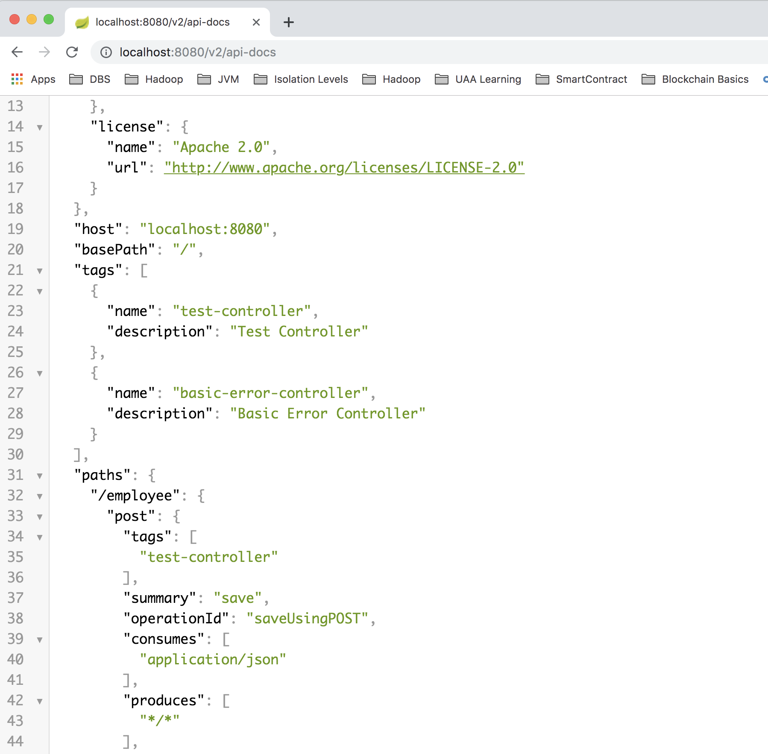
Access the URLs http://localhost:8080/v2/api.docs

Slide 18
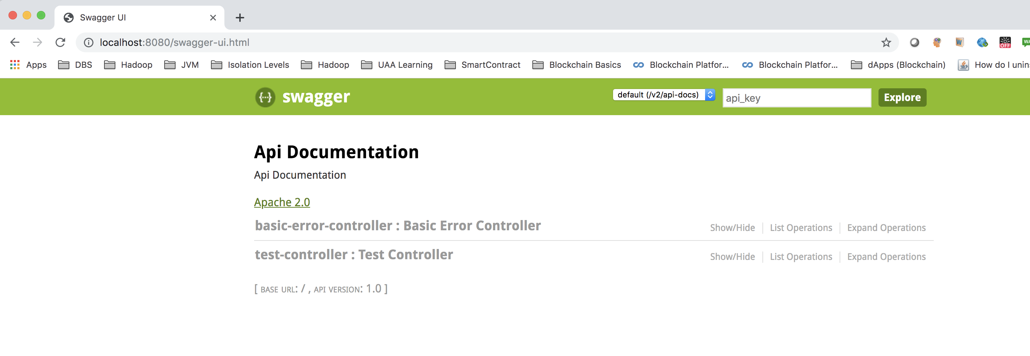
Swagger-ui http://localhost:8080/swagger-ui.html

Slide 19
ACTUATOR

Slide 20
Things to do
1. Add the starter dependency for Actuator
2. access the URL:
https://localhost:8080/actuator

Slide 21
URLs
Now in application.properties add:
management.endpoints.web.exposure.include=*
management.endpoints.web.exposure.exclude=loggers
(Don’t use * in prod as it may hit the performance. Use only those beans which you really want)
And access the URL
https://localhost:8080/actuator
http://localhost:8080/actuator/metrics

Slide 22
Versioning

Slide 23
Why versioning is required?
When your API has reached the point of expanding beyond it’s original intent and capacity, it’s time to consider the next version.

Slide 24
URI Versioning
http://localhost:8080/v1/student
http://localhost:8080/v2/student
@RestController
public class StudentVersioningController {
@GetMapping("v1/student")
public StudentV1 studentV1() {
return new StudentV1("Bob Charlie");
}
@GetMapping("v2/student")
public StudentV2 studentV2() {
return new StudentV2(new Name("Bob", "Charlie"));
}
}

Slide 25
Request Parameter versioning
http://localhost:8080/student/param?version=1
http://localhost:8080/student/param?version=2
@RestController
public class StudentVersioningController {
@GetMapping(value = "/student/param", params = "version=1")
public StudentV1 paramV1() {
return new StudentV1("Bob Charlie");
}
@GetMapping(value = "/student/param", params = "version=2")
public StudentV2 paramV2() {
return new StudentV2(new Name("Bob", "Charlie"));
}
}

Slide 26
(Custom) Headers versioning
http://localhost:8080/student/header
headers=[X-API-VERSION=1]
http://localhost:8080/student/header
headers=[X-API-VERSION=2]
@RestController
public class StudentVersioningController {
@GetMapping(value = "/student/header", headers = "X-API-VERSION=1")
public StudentV1 headerV1() {
return new StudentV1("Bob Charlie");
}
@GetMapping(value = "/student/header", headers = "X-API-VERSION=2")
public StudentV2 headerV2() {
return new StudentV2(new Name("Bob", "Charlie"));
}
}

Slide 27
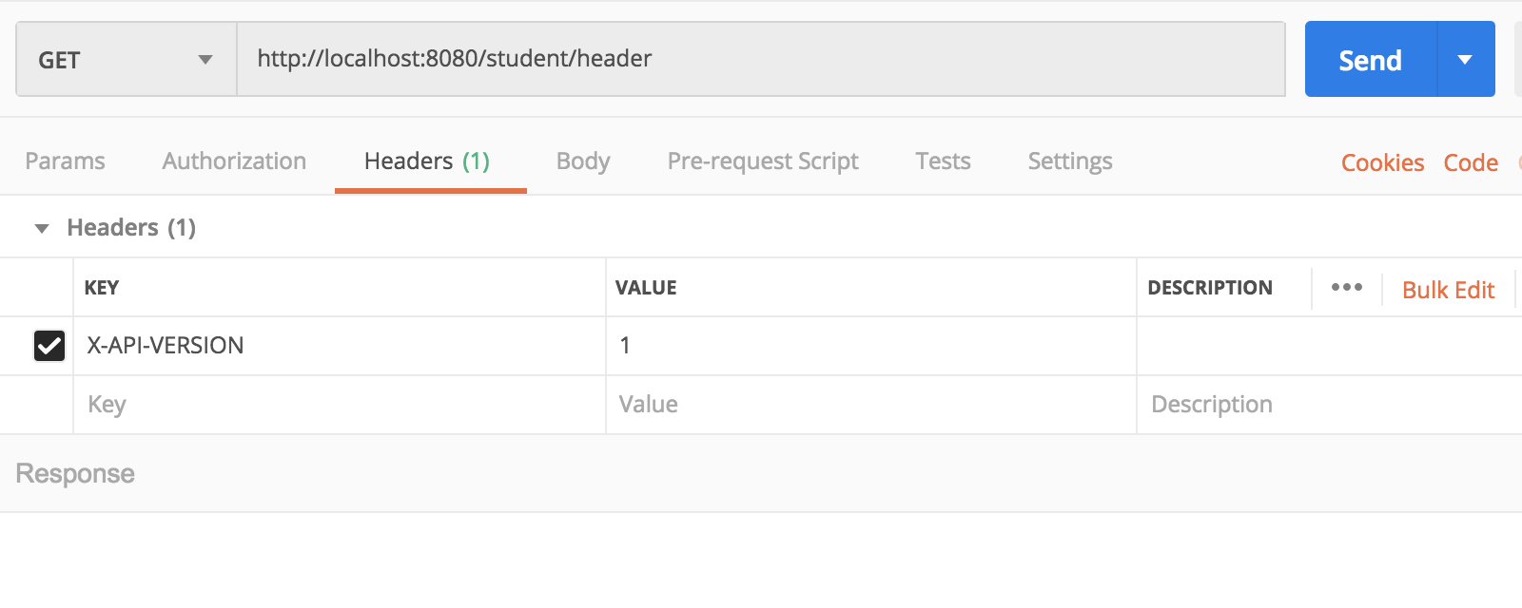
Testing in postman

Slide 28
Media type versioning or (“content negotiation” or “accept header”)
http://localhost:8080/person/produces
headers[Accept=application/vnd.company.app-v1+json]
http://localhost:8080/person/produces
headers[Accept=application/vnd.company.app-v2+json]
@RestController
public class StudentVersioningController {
@GetMapping(value = "/student/produces",
produces = "application/vnd.company.app-v1+json")
public StudentV1 producesV1() {
return new StudentV1("Bob Charlie");
}
@GetMapping(value = "/student/produces",
produces = "application/vnd.company.app-v2+json")
public StudentV2 producesV2() {
return new StudentV2(new Name("Bob", "Charlie"));
}
}

Slide 29
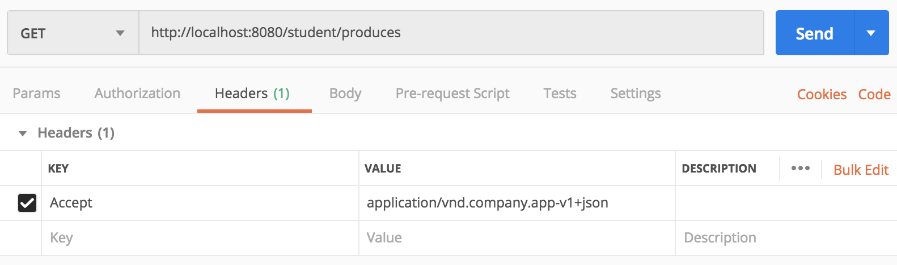
Testing in postman

Slide 30

Questions
Send to skkar.2k2@gmail.com

